Slide 1


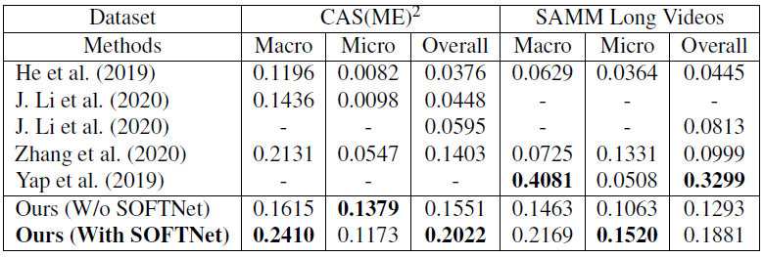
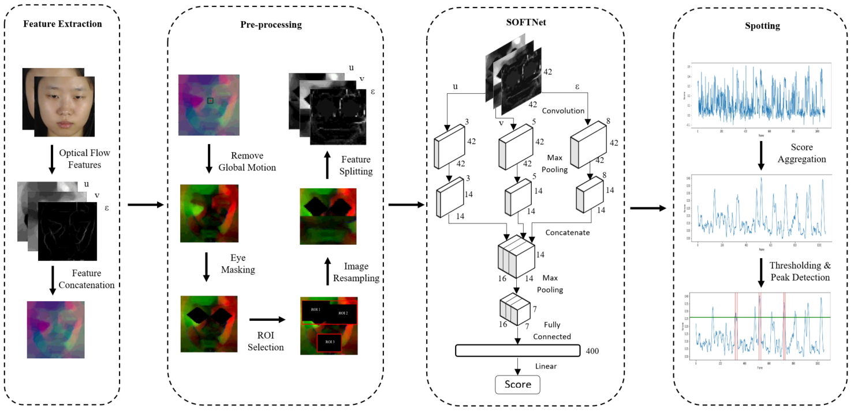
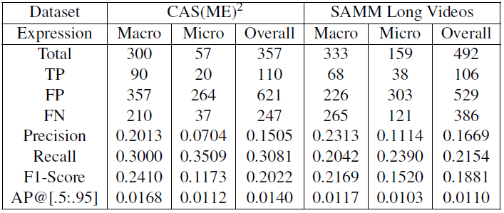
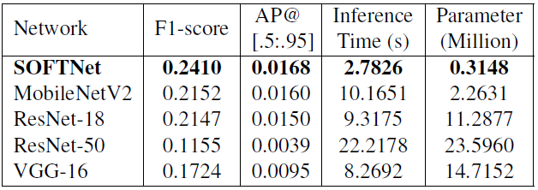
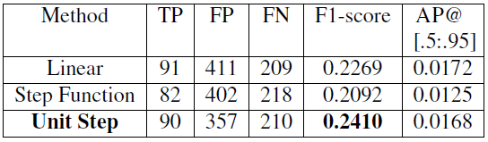
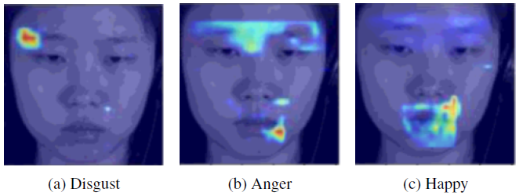
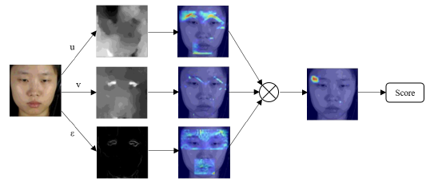
1661: Detecting Micro-Expression Occurrences in Videos
Results and Discussions
Liong Gen Bing 1161104505
Supervisor: Dr. John See Su Yang Moderator: Dr. Wong Lai Kuan
Comparison between proposed approach against MEGC 2020
Our approach (With SOFTNet) outperforms other methods on CAS(ME)² while ranked-second on SAMM Long Videos, behind the original dataset authors.
Detail result of proposed SOFTNet approach
The amount of TP that we obtained is comparable with other approaches whilst with a much lower FP.
Performance comparison on CAS(ME)² macro-expression
SOFTNet model shows the superiority across various aspects from accuracy to efficiency.
In pseudo-labeling, unit step outperforms the other functions.
Class Activation Maps
Conclusion
We propose a new regression-based strategy towards macro- and micro-expression spotting in long videos and achieved promising results on MEGC 2020 benchmark. We re-introduce the AP@[.5:.95] metric for a more consistent measure across expressions.
Abstract
Research Methodology
Micro-expression is subtle and occurs when a person intends to conceal or suppress their inner feeling in high-stake situations. To spot the occurrences, Shallow Optical Flow Three-stream CNN (SOFTNet) model is proposed to predict a score that captures the likelihood of a frame being in an expression interval. By fashioning the spotting task as a regression problem, unit step function is introduced to pseudo-label the frames in the learning process. We demonstrate the efficacy and efficiency of the proposed approach on the recent MEGC 2020 benchmark, where state-of-the-art performance is achieved on CAS(ME)² with equally promising results on SAMM Long Videos.
Proposed Approach
Feature Extraction - Extract the optical flow features (u, v, ε) that represents each frame.
Pre-processing - Remove global head motion, eye masking, ROI selection, and image resampling.
SOFTNet - Three-stream shallow architecture that takes inputs (u, v, ε) and outputs a spotting confidence score.
Spotting - Smoothing spotting confidence score, then perform thresholding and peak detection.
Dataset
CAS(ME)² – Contains 98 long videos with 300 macro and 57 micro-expressions from 22 subjects.
SAMM Long Videos – Contains 147 long videos with 343 macro and 159 micro-expressions from 32 subjects. Most culturally diverse datasets in this domain.
Evaluation
Leave-One-Subject-Out (LOSO)
cross-validation
F1-Score (MEGC 2020)
AP@[.5:.95] (Proposed)
Objectives
To design and develop a robust approach for spotting facial micro- and macro-expression occurrences from the long videos.
To understand the limitation of methodologies in literature and adopt the suitable techniques with some improvements.
To establish a viable metric of measuring the efficacy of locating facial expression occurrences and validate the proposed approach.
Literature Review
Pre-processing
Eye Masking (Liong et al., 2016)
ROI Selection (Liong et al., 2015, 2016), (J, Li et al., 2018)
Spotting
LBP-χ² (Moilanen et al., 2014)
LTP-ML (J, Li et al., 2018)
MDMD (He et al., 2019)
Contribution
We propose a multi-stream shallow network infused with optical flow inputs to regress a score for spotting.
We present a new automatic way of pseudo-labeling frames to enable the training of a regression model.
We demonstrate the efficacy of the proposed approach with few extensive experiments.
We re-explore the viability of a spotting metric to provide a fairer and more consistent measure for locating both macro- and micro-expression occurrences.
SOFTNet is able to learn from facial regions that correspond to the Action Unit triggered.
Notes:
Empty Template

Slide 2
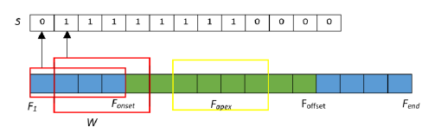
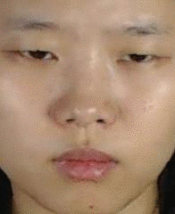
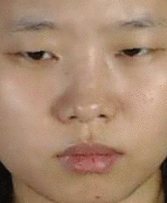
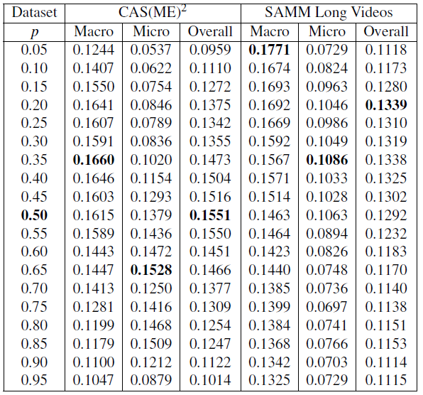
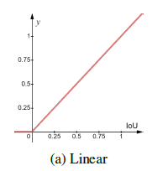
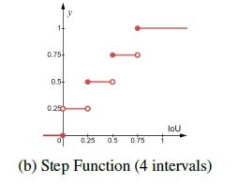
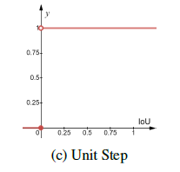

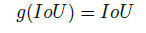
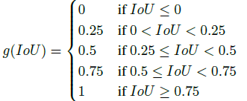
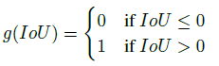
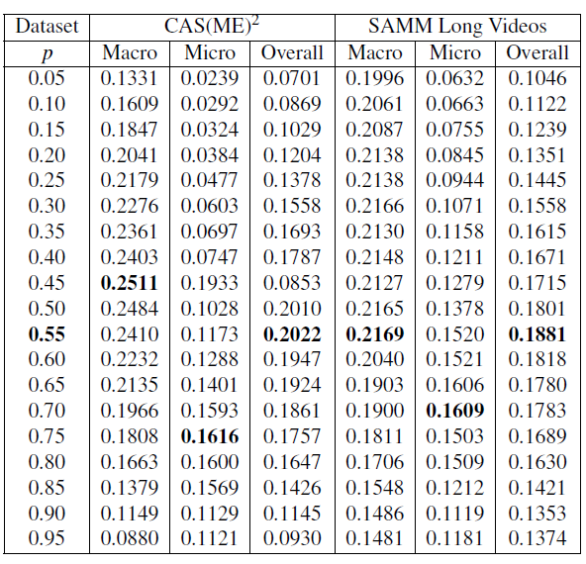
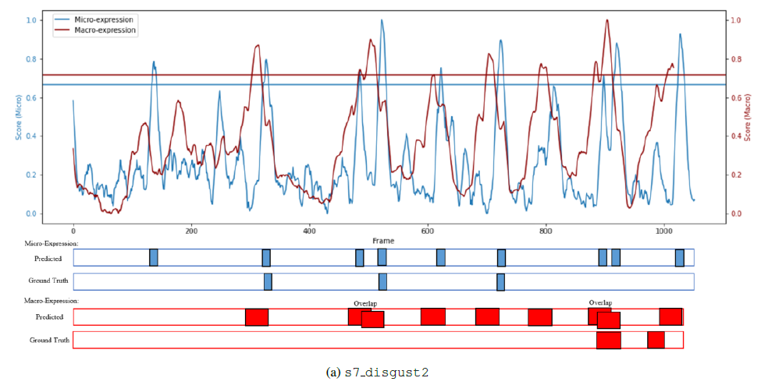
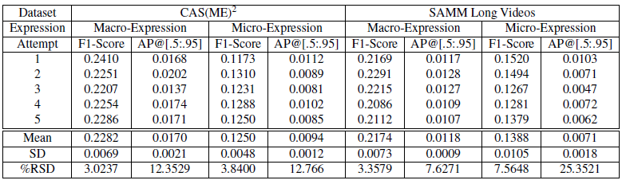
Supplementary
Example of Expression
Pseudo-labeling
Parameter Selection
Micro-Expression
Macro-Expression
Results in terms of F1-Score
Without SOFTNet
0.3s
1.73s
Example of when a person is lying
Visualization
With SOFTNet
Result for 5 attempts

